Slide 1

Operating Systems Design (19CS2106S ) Session 3 & 4 Revision

Slide 2
Session-3-Revision
Operating System Interfaces
User & Kernel Mode
System Calls
Kernel Organization

Slide 3
Operating System Interfaces
An operating system provides services to user programs through an interface.
Designing a good interface turns out to be difficult.
Preferably, the interface to be simple and narrow because that makes it easier to get the implementation right.

Slide 4
Popular Computing Device Interfaces
Command Line Interface(CLI)
Graphical User Interface(GUI)

Slide 5
Review of Basics
A kernel, a special program that provides services to running programs.
Each running program, called a process, has memory containing instructions, data, and a stack.
The instructions implement the program’s computation.
The data are the variables on which the computation acts.
The stack organizes the program’s procedure calls.

Slide 6
System Call
When a process needs to invoke a kernel service, it invokes a procedure call in the operating system interface. Such a procedure is called a System Call
The system call enters the kernel; the kernel performs the service and returns.
The shell is an ordinary program that reads commands from the user and executes them.

Slide 7
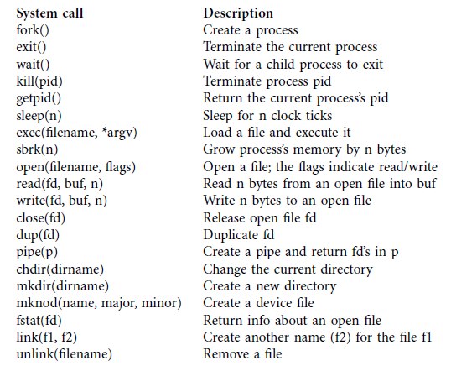
Various System Calls in xv6

Slide 8
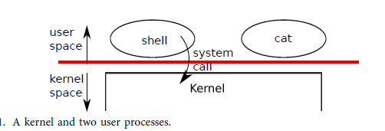
Understanding User & Kernel Space

Slide 9
As shown in the diagram, the system call works in TWO regions/spaces called User space & Kernel space.
Strong isolation requires a hard boundary between applications and the operating system.
Initially the system call will be with the process and is in User space
When the process seeks some service from kernel, then the system call enters into kernel space.
Once the kernel performs the service, then the system call returns to the user space.

Slide 10
An application can execute only user-mode instructions (e.g., adding numbers, etc.) and is said to be running in user space, while the software in kernel mode can also execute privileged instructions and is said to be running in kernel space.
The software running in kernel space (or in kernel mode) is called the kernel.

Slide 11
In kernel mode ,the processor is allowed to execute privileged instructions.
For example, reading and writing the disk (or any other I/O device) involves privileged instructions.
If an application in user mode attempts to execute a privileged instruction, then the processor doesn’t execute the instruction, but switches to kernel mode so that the software in kernel mode can clean up the application, because it did something it shouldn’t be doing

Slide 12
Kernel Organization-Monolithic Vs Micro
In Monolithic Kernel, the entire operating system resides in the kernel, so that the implementations of all system calls run in kernel mode.
In this organization the entire operating system runs with full hardware privilege.
This organization is convenient because the OS designer doesn’t have to decide which part of the operating system doesn’t need full hardware privilege.

Slide 13
Issues with Monolithic Kernel
In a monolithic kernel, a mistake is fatal, because an error in kernel mode will often result in the kernel to fail.
If the kernel fails, the computer stops working, and thus all applications fail too.
The computer must reboot to start again.

Slide 14
Micro Kernel
To reduce the risk of mistakes in the kernel, OS designers can minimize the amount of operating system code that runs in kernel mode, and execute the bulk of the operating system in user mode.
This kernel organization is called a microkernel

Slide 15
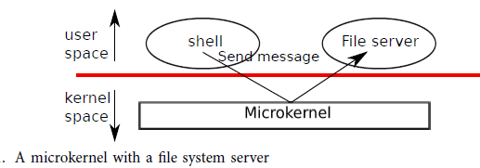

Slide 16
Process Creation
A process may create a new process using the fork system call.
fork creates a new process, called the child process, with exactly the same memory contents as the calling process, called the parent process.
fork returns in both the parent and the child.
In the parent, fork returns the child’s pid; in the child, it returns zero

Slide 17
Code to implement fork
#include”type.h”
#include”stat.h”
#include”user.h”
int main(vod)
{
Int pid = fork();
if(pid > 0){
printf("parent: child=%d\n", pid);
pid = wait();
printf("child %d is done\n", pid);
} else if(pid == 0){
printf("child: exiting\n");
exit();
} else {
printf("fork error\n");
}

Slide 18
Output
parent: child=1234
child: exiting

Slide 19
I/O and File Descriptors
A file descriptor is a small integer representing a kernel-managed object that a process may read from or write to.
A process may obtain a file descriptor by opening a file, directory, or device, or by creating a pipe, or by duplicating an existing descriptor.
By convention, a process reads from file descriptor 0 (standard input), writes output to file
descriptor 1 (standard output), and writes error messages to file descriptor 2 (standard error).

Slide 20
read and write System Calls
The read and write system calls read bytes from and write bytes to open files named by file descriptors.
The call read(fd, buf, n) reads at most n bytes from the file descriptor fd, copies them into buf, and returns the number of bytes read.
Each file descriptor that refers to a file has an offset associated with it.
The call write(fd, buf, n) writes n bytes from buf to the file descriptor fd and returns the number of bytes written.

Slide 21
To copy data from its standard input to its standard output
#include”type.h”
#include”stat.h”
#include”user.h”
int main(vod)
{
char buf[512];
int n;
for(;;){
n = read(0, buf, sizeof buf);
if(n == 0)
break;
if(n < 0){
fprintf(2, "read error\n");
exit();
}
if(write(1, buf, n) != n){
fprintf(2, "write error\n");
exit();
}
}

Slide 22
Review of Session-4
xv6 Functions Case Study : getblk, brelse, bread, bwrite.

Slide 23
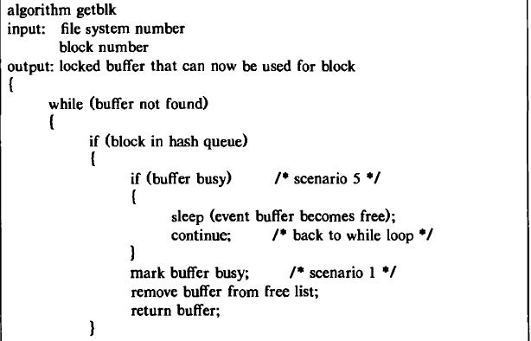
getblk-Algorithm for Buffer alocation

Slide 24
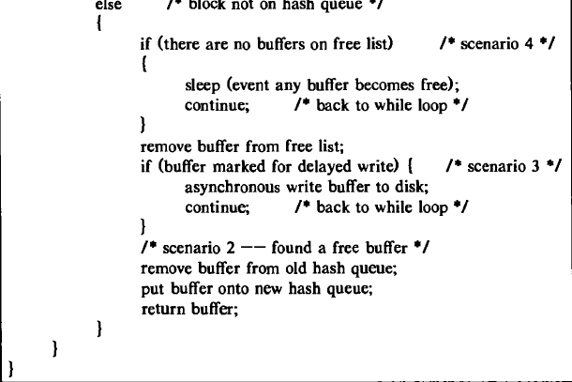

Slide 25
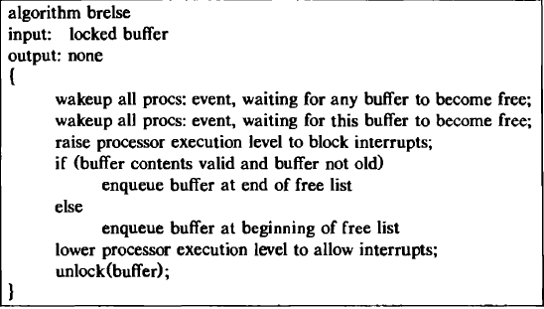
brelse-Algorithm for Releasing Buffer

Slide 26
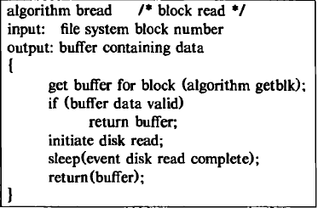
bread-Algorithm for reading a disk block

Slide 27
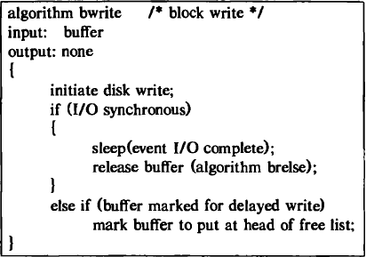
bwrite-Algorithm for writing a disk block

Slide 28
Exploring bio.c file
It’s an xv6 file that consists of the code sheets of all the algorithms of the topic Buffer Cache.

Slide 29
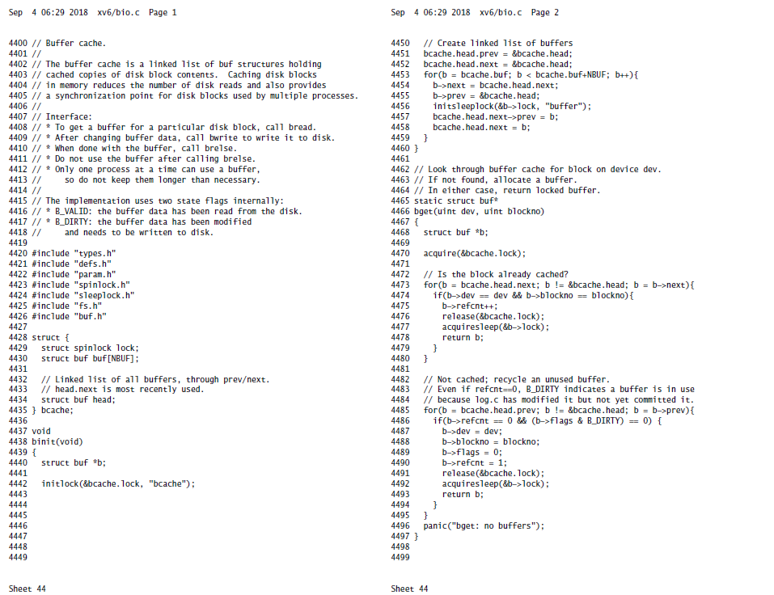
Exploring bio.c

Slide 30
LTC Activity on fork.c & io.c -in Breakout Session

